Slide 1
Into the Atmosphere
Back to living things

Slide 2
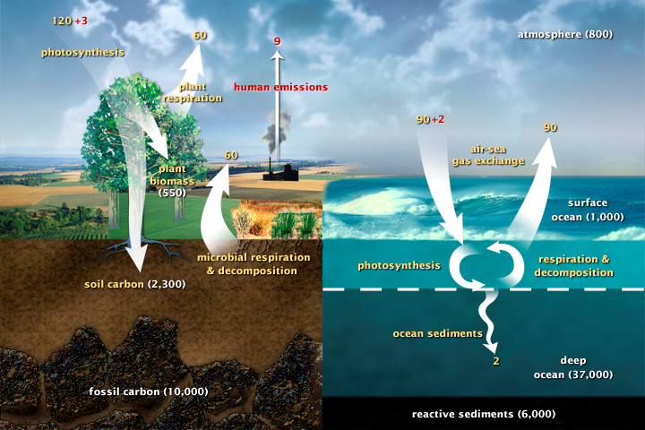
Carbon Cycle

Slide 3
C in Air
Respiration (C₆H₁₂O₆ + O₂ -> CO₂ + H₂O + ATP)
Methane (from cow flatulence/farts)
Burning fossil fuels (cars, factories, fireplaces, etc.)

Slide 4
C back to living things
Photosynthesis (plants, algae, some bacteria)

Slide 5
Into the ground
Back to living things

Slide 6
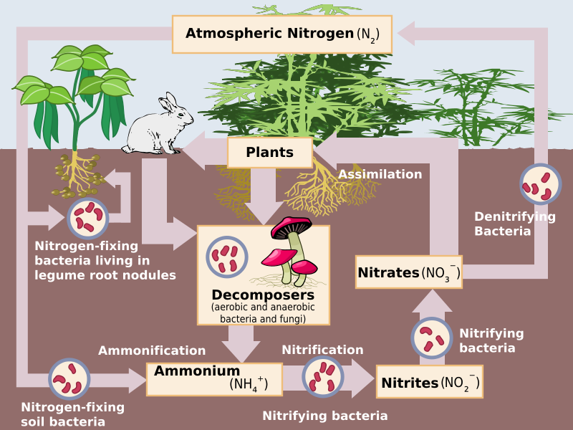
Nitrogen Cycle

Slide 7
N in ground
Urine (ammonium NH₄⁺)
Dead animals (decomposition)
Don’t forget our atmosphere is 70% N₂

Slide 8
N back to living things
Nitrogen fixation
Bacteria on the roots of legume (bean) plants
Lightning in atmosphere
Plants take up fixed nitrogen (Nitrates and Nitrites) as nutrition

Slide 9
Into the Ground/Water
Back to living things

Slide 10
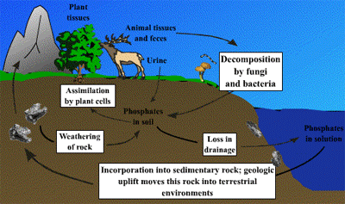
Phosphorous Cycle

Slide 11
P in water
Runoff from rocks
Leaching (going) into soil from decomposed dead things
Fertilizer runoff
* Too much Phosphorous in water causes algae bloom so fish suffocate

Slide 12
P back to living things
Living things such as plants and algae use it as a nutrient

Slide 13
Into atmosphere
Back to Earth

Slide 15
Water in air
Evaporation
Sublimation-solid turning into gas
Transpiration – water leaving leaves of plant

Slide 16
Water back to land
Precipitation: snow, rain, sleet

